Slide 1


September 29-30 2023
NuttX VirtIO Framework and Future Work
Wang Bowen, Vela OS Team, Xiaomi
Notes:
Hello, everyone, my name is Wang Bowen and I’m a member of the Vela OS team at Xiaomi.
I’m going to talk about the NuttX Virtio Framework and its future work.

Slide 2

NuttX Online Workshop
Overview
Introduction to VirtIO
VirtIO Architecture
VirtIO Device Basis
How the virtqueue transfer data
NuttX VirtIO Framework
Framework Architecture
VirtIO API
How a VirtIO Driver works
Future Work about the NuttX Virtualization
VirtIO PCI Transport support
Vhost (Virtual host) framework
Vsock (Virtual socket) support
Notes:
I have divided my presentation into three sections and here is the overview:
First, I will briefly introduce the virtio, about the virtio architecture, virtio driver/deivice and how virtqueue transfer data;
Next I will talk about the nuttx virtio framework, about it's architecture and take the virtio block driver as the example to show how a virtio driver work ;
Finally, I will talk about some future works of the virtualization in NuttX;
Now let’s move to the first section.

Slide 3
NuttX Online Workshop
Introduction to VirtIO

Slide 4
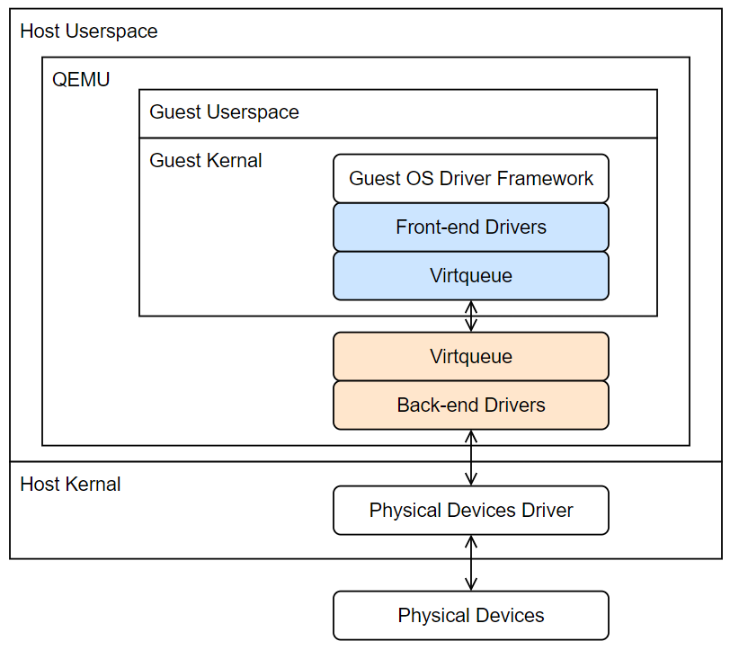
NuttX Online Workshop
VirtIO Architecture
VirtIO (virtual input & output) is an interface that allows a virtual machine to use its host’s devices.
VirtIO Drivers: Front-end Drivers in Guest OS, accept IO requests from user and transfer them to Back-end Drivers.
VirtIO Devices: Back-end Drivers in Hypervisor, handle the IO requests by offloading them to host’s physical hardware.
VirtQueues: Communication channel between Driver and Device. They exist both in Driver and Device side and their implementations must follow the same standard from virtio spec.
Figure 1
Notes:
Firslty, I want to introduce the VirtIO architecture
VirtIO, or virtual input & output, is an interface that allows a virtual machine to use its host’s devices.
As you can see in the right figure, the virtio architecture can be divided into three parts,
The first part is the virtio drivers, the bule one in the figure, we also called these drivers the front-end drivers, and they are located in the Guest OS, these drivers receive the IO request from user and send them to the Back-end drivers to do the real IO operations;
The second part is the virtio devices and located in the Hypervisor, they handle the io request from corresponding virtio drivers by offloading them to the host’s physical hardware.
The last key part is the virtqueue, virtqueue is the communication channel between the driver and device.
In NuttX, for now, we only implement the VirtIO Drivers and the Virtqueues.
Let’s moving on to next

Slide 5
NuttX Online Workshop
VirtIO Device Basis
Five basic parts:
Status: Indicate the driver’s status in device initialization.
Example: Driver set status to DRIVER_OK (2) to notify the Device that it can start drive the device
Feature bits: VirtIO use bit filed to represent the driver and device supported features
Example from virtio spec: VIRTIO_BLK_F_RO (1 << 5, Bit 5) indicates the device is read only, driver should read this bit first and should not send write request to the device if bit 5 is set.
Configuration Space: device provide some configuration data to driver. e.g., the virtio block device places total sector number in the configuration space, so the virtio block driver need read the configuration space in the driver initialization to get the this value.
Virtqueues & Notifications: they are used to transfer data between the device and driver. Next page I will describe this process in detail.
Notes:
Next I will introduce the basis of the virtio deivce
The virtio device contains five parts:
The first is the status, During device initialization by a driver, driver set the status to different value to control the device, and the driver also can set the staus to zero to reset the virtio device;
The second is feature bits, virtio use the bit field to represent the supported feature by a driver or device. And of course, the same bit has different meaning for different virtio device. In the device initialization, the device sets its supported feature to the feature bit, then driver reads this and tell the device the accepted feature.
The next part is configuration space, the configuration space is provided by the device to make driver know the device configuration. For example, the virtio block driver can get the sector size of the virtio block device form this configuration space.
4. The finally parts are virtqueues and notifications, virtqueues are used to send or recv data and notifications are used to trigger the interrupt to make driver/device can process the data as soon as possible. And About how the virtqueue transfer data, I will introduce it in the next slide.
Let’s moving on to the next slide

Slide 6
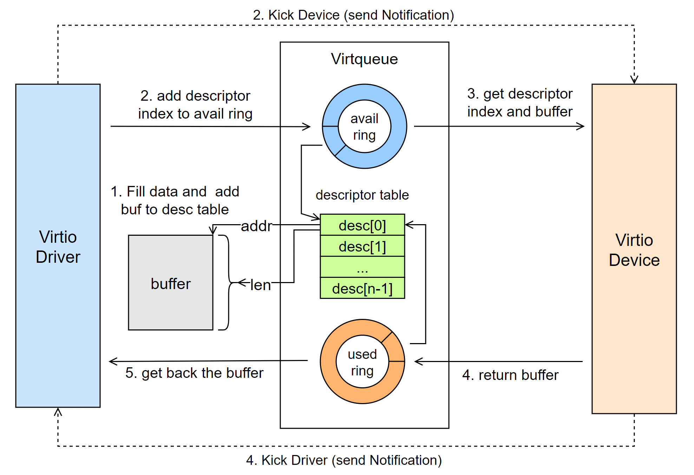
NuttX Online Workshop
VirtQueues & Notifications
Descriptor table: a table to manage the buffer, one descriptor can describe a buffer by using address and length.
Avail and Used ring: ring buffer that store the descriptor table index
Data Send process:
0. Allocate a buffer from the shmem
Driver fill the send data to buffer and add it to descriptor table
Driver add descriptor index to avail ring and kick device
Device get buffer from avail ring
Device consumed the buffer, return to used ring and kick driver
Driver get back the buffer and free buffer, the send process finished.
Figure 2
Notes:
The right figure shows the data transfer process from driver to device.
Before introducing this process, I would like to briefly introduce the virtqueue.
As you can see in the middle of the figure, the virtqueue can be divided into three parts: the avail ring, used ring and the descriptor table
The element in descriptor table describe a buffer by using address and length. And the avail and used ring only store the descriptor table index. So once you get a index from the ring, you can find the corresponding buffer from the descriptor table.
Let’s back to the data transfer process:
For driver, the first thing to send a data to device is allocating a share memory and fill data to it and add this buffer to the descriptor table;
Then add the index to the avail ring and send a notification to the device, To notify the device has data handle;
Next, device get the descriptor index and find the buffer from the descriptor table;
After device consumed the buffer, it will return the corresponding descriptor table index to used ring and send a notification to the driver;
Finally, driver get back the buffer.
A important note is that the share buffer is managed by virtio driver, this is why the device has to return the buffer to driver instead keep it.
And this is how the driver and deivce communicated with virtqueue and notification.

Slide 7
NuttX Online Workshop
NuttX VirtIO Framework
Notes:
The virtio introduce has finished, and the next section is the NuttX Virtio Framework

Slide 8
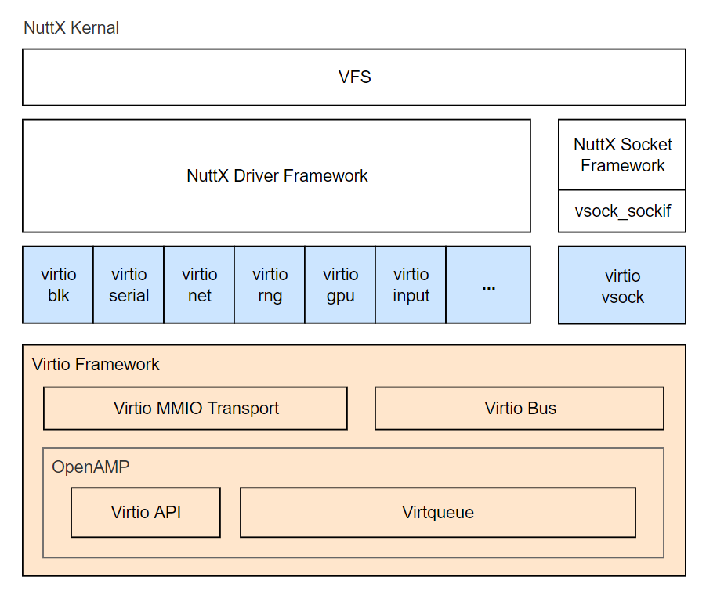
NuttX Online Workshop
VirtIO Framework Architecture
VirtIO Drivers: follow virtio spec, convert the io requests from driver framework to the virtio operations.
VirtIO Framework:
OpenAMP: is a library for AMP (Asymmetric Multi-Processing) system and has provided the most virtio api
NuttX: two new features based on OpenAMP
MMIO Transport: make the virtio drivers can interact with virtio mmio devices
VirtIO bus: provides a match mechanism for the virtio driver and device
Figure 3
Notes:
The right figure shows the NuttX virtio framework architecture,
The blue parts represent some virtio drivers in NuttX
The orange parts represent the Virtio Framework, and the OpenAMP is a libray that has implemented the most virtio api. The NuttX virtio freamwork is base on it.
In the NuttX part of the virtio framework, we add the MMIO transport support and implement a virtio bus.
The MMIO transport make virtio driver can interact with the virtio mmio devices.
And the virtio bus make the virtio driver probe and remove become easy.

Slide 9
NuttX Online Workshop
VirtIO API
void virtqueue_add_buffer(struct virtqueue *vq, struct virtqueue_buf *buf_list,
int readable, int writable, void *cookie)
Data send API. Add a buffer list to the virtqueue, then the device can receive this buffer list.
------------------------------------------------------------------------------------------------------------------------------------------
void virtqueue_kick(struct virtqueue *vq)
Notification API, call this function to send a notification/interrupt to virtio device.
Normally, we always follow a virtqueue_kick() after a virtqueue_add_buffer(), so the device can handle the driver’s requests ASAP.
------------------------------------------------------------------------------------------------------------------------------------------
void *virtqueue_get_buffer(struct virtqueue *vq, uint32_t *len, uint16_t *idx)
Data recv API. Get the buffer returned by virtio device.
The return value is the cookie passed in virtqueue_add_buffer().
Notes:
The virtqueue API is the most commonly used API in the virtio driver, In the next page, I will introduce you how a virtio driver work, I will introduce these API to you first :
The first introduced api is the virtqueue_add_buffer(), this api can add a buffer list to the virtqueue, and then the device can receive this buf list.
The second api is the virtqueue_kick(), this api can notify the device when you want the device to handle the buffer in virtqueue.
Normally, you can follow a virtqueue_kick() once add a buffer to the virtqueue, so the device can handle the buffer as soon as possible.
The last api is virtqueue_get_buffer(). after device consumed the buffer, the device will return the buffer to the virtqueue, and driver can use this api to get the returned buffer.
It should be note the return value is the cookie passed in virtqueue_add_buffer().
This is a very useful feature because you can use cookie to get the context in the buffer send process.
The next slide will show you how a virtio driver work and you can see the benefits of this feature. So let’s moving on

Slide 10
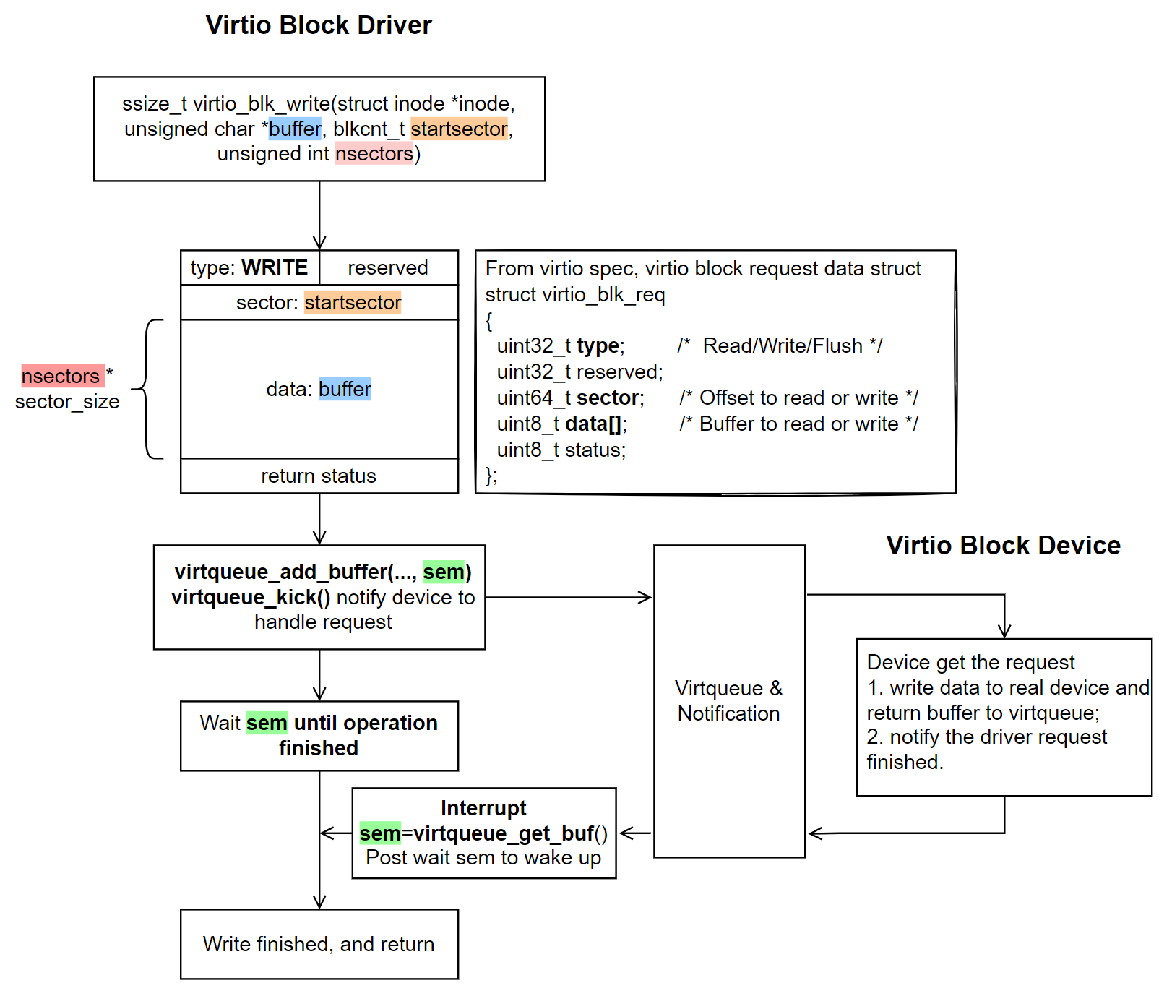
NuttX Online Workshop
How VirtIO Driver Work?
nuttx/drivers/virtio/virtio-blk.c
Driver:
Follow virtio spec, build the WRITE request
Call virtqueue_add_buffer(…, sem) add request to the virtqueue
Call virtqueue_kick() notify device
Wait sem until device finished write
Device:
Device get the request and write data to real device, then return the request to virtqueue and notify driver write has finished
Back to Driver:
In driver’s interrupt, post the wait sem
Write operation finished
Figure 4
Notes:
In this page, example
Upstreamed, source code
Read op initialied by user
In this page, I will take the virtio block driver read operation as an example to show you how the virtio driver interacts with the virtio device.
The driver source code can be found in nuttx/drivers/virtio/virtio-blk.c
Right figure shows the whole process of the virtio block driver read operation. And we have some simple description in the left.
In the virtio block read function, the first thing is to follow the virtio spec to build a block request, the block request sturct has placed in the figure.
Based on the virtio spec
The type in the virtio_blk_req represent the request type, can be set to READ or WRITE, we set this value be READ, because this is a read operation.
The sector represent the offset sector you want to READ or WRITE, so we set this value be startsector
The data represent the buffer you want to be fill or write, so we place the user buffer here
And finally the status represent the device returned value, will be returned to user after this operation finished.
Then we call virtqueue_add_buffer() add the request to the virtqueue and call virtqueue_kick() to notify the device to handle the io request.
Here we passed a semaphore as the cookie and driver will wait this semaphore to be post.
When device get the request and fill the data to the user buffer and notify the driver. An interrupt will be triggered in driver side,
In this intterrupt, driver call virtqueue_get_buf() to get the return buffer and the semaphore passed in virtqueue_add_buffer(),
then we post this semaphore and the user thread be waked up and return.
And now the read operation finished.

Slide 11
NuttX Online Workshop
Future Work
Notes:
The Virtio Framwork part has finished, let’s moving on to the next section, talk about the future work.

Slide 12
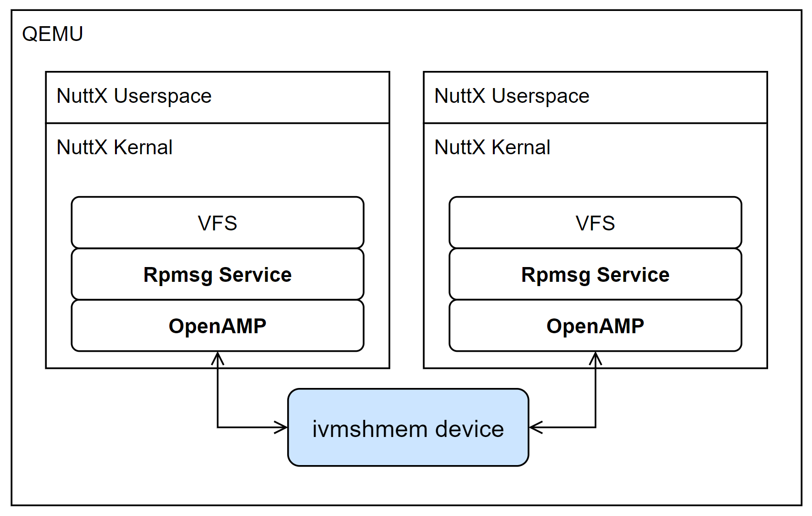
NuttX Online Workshop
VirtIO PCI Transport Support
For complex applications, only support mmio transport is not enough.
e.g., ivshmem (Inter-VM share memory) device can allows VMs to communicate with each other via a shared memory and also provide the interrupt mechanism.
If we want two NuttX running in the qemu to use the rpmsg service (such as rpmsgfs, rpmsg socket), we need use this device, because the rpmsg is based on the share memory and the interrupt. but this device only supports PCI transport for now
Figure 5
Notes:
The first future work is to support the PCI transport layer.
NuttX has supported the MMIO transport and can use the mmio deivces in qemu, but if you want to emulate a complex applications,
Only support mmio devices is not enough.
For example, if we want two NuttX running in the qemu to use the rptun framework to achieve the cross core communication, we must use the Inter-VM share memory device, but this device only support the PCI transport.

Slide 13
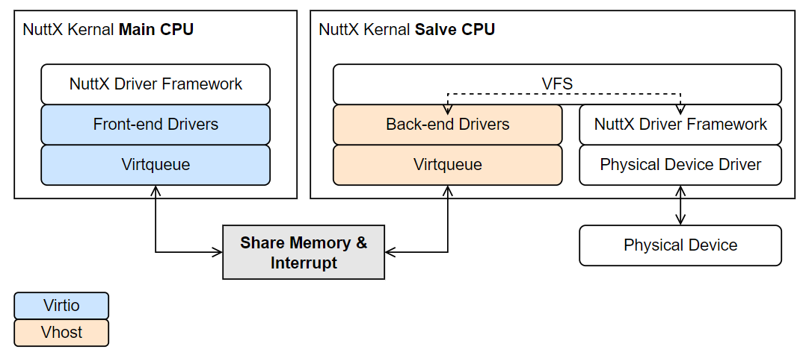
NuttX Online Workshop
Vhost (Vitual Host) Framework
Main CPU applications access the physical device in salve CPU direclty.
Moreover, Vhost framework is also necessary for the full support of the virtual socket.
Figure 6
Notes:
The second future work is the vhost (Virtual Host) framework.
Virtio Framework provide the ability to write virtio front-end drivers, while the corresponding Vhost framework provides the ability to write back-end drivers.
As you can see in the figure, the orange color represents the vhost framework and the back-end drivers. With the virtio and vhost framework, we can make the main cpu directly access the physical device in the salve CPU. And the process is insensitive to user.

Slide 14
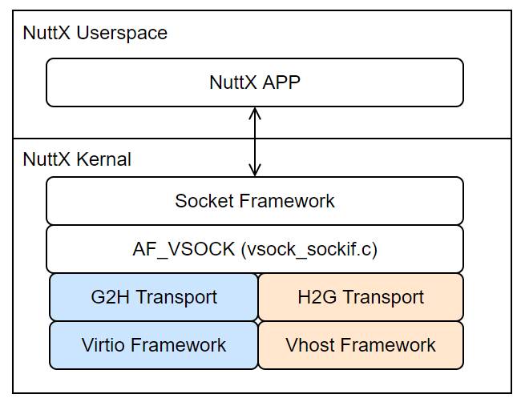
NuttX Online Workshop
Vsock (Virtual Socket)
Vsock is a fast and efficient communication mechanism between guest virtual machines and their host
Three parts:
An Interface to the NuttX socket framework (vsock_sockif.c)
Guest to Host (G2H) Transport based on the virtio framework, used to communicate with Host
Host to Guest (H2G) Transport based on the vhost framework, used to communicate with Guest
Figure 7
Notes:
The last future work is the Virtual socket support. Virtual socket (vsock) is a fast and efficient communication mechanism between guest virtual machines and their host.
Virtual socket contains three parts:
The first is an Interface to the NuttX socket framework (vsock_sockif.c) ;
The second part is Guest to Host (G2H) Transport based on the virtio framework;
And the last part is Host to Guest (H2G) Transport based on the vhost framework;
In the right figure, we can see that if we implement Guest to Host transport, the nuttx application can communicate with the application in linux though the vsock.

Slide 15
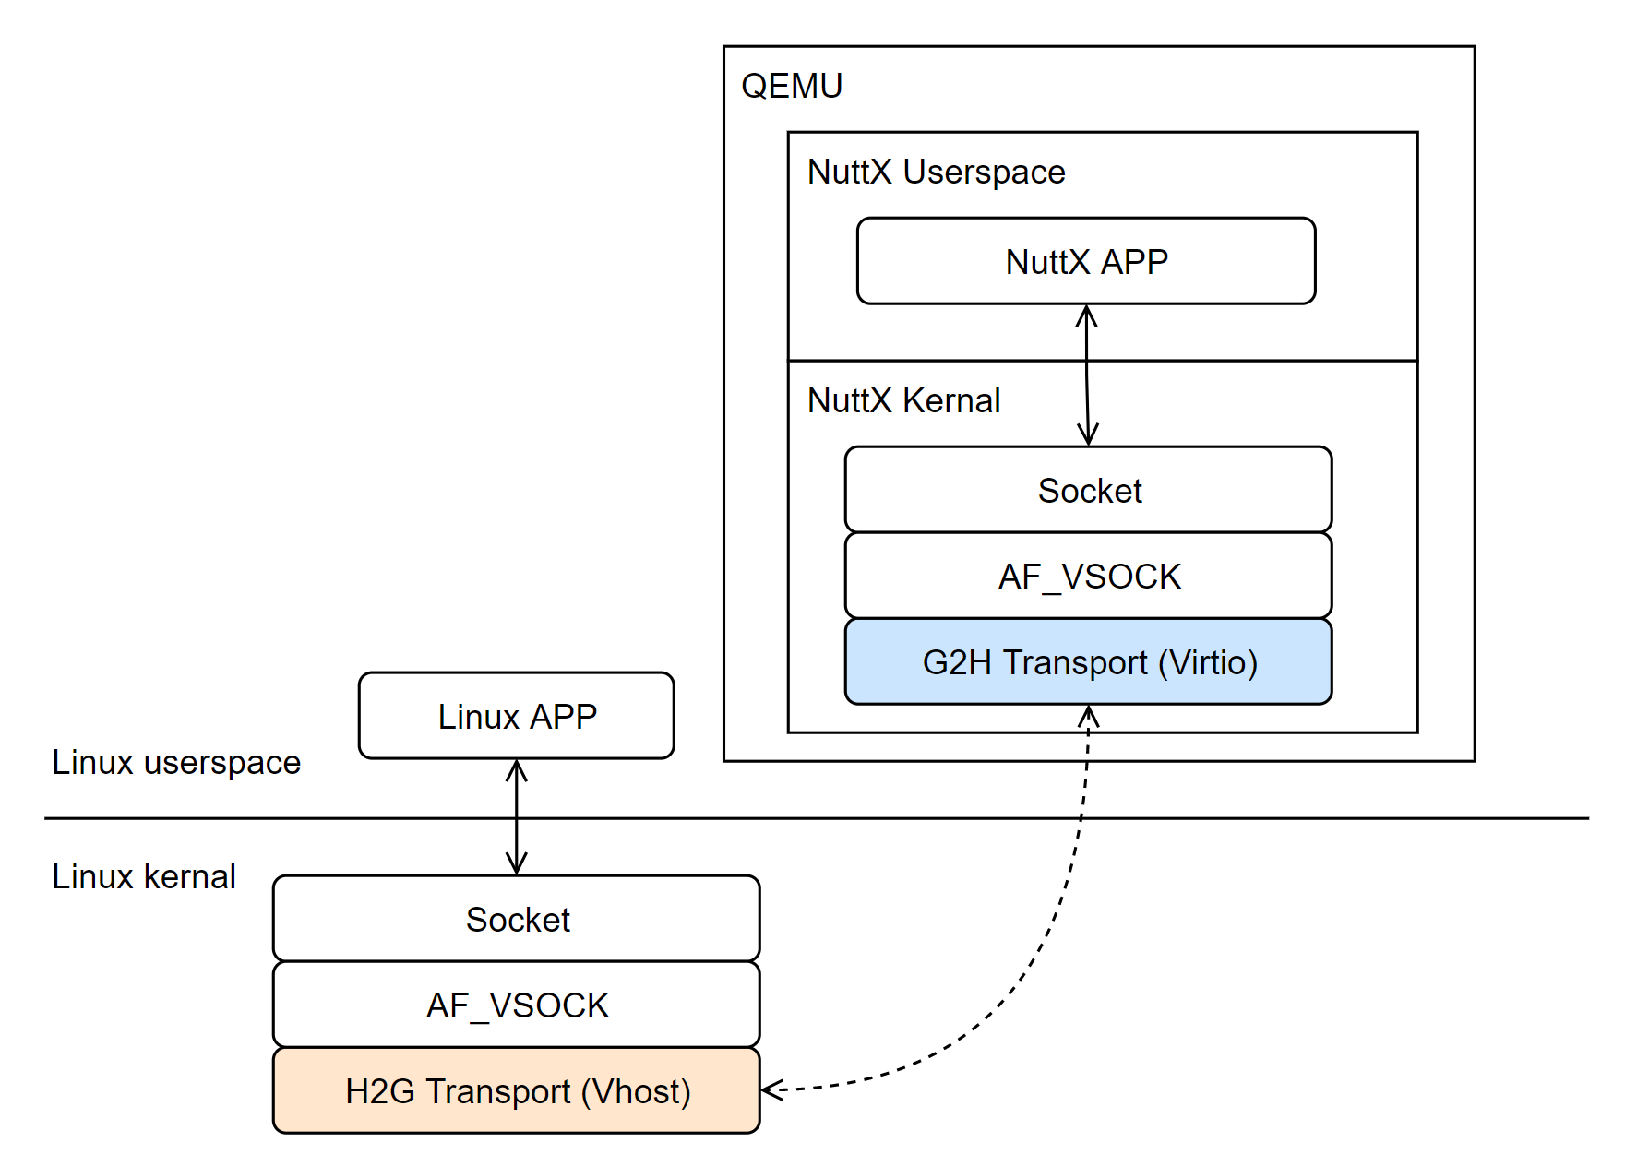
NuttX Online Workshop
Vsock G2H Transport
Because linux has implemented the H2G transport, so NuttX applications running in QEMU can communicate with the Linux application
With standard socket api socket(), bind(), listen(), connect(), recv(), send() with AF_VSOCK address family
Good news, G2H Trassport only depends on the virtio framework, so this work is already in progress
Figure 8
Notes:
In the right figure, we can see that if we implement Guest to Host transport, the nuttx application can communicate with the application in linux though the vsock.

Slide 16
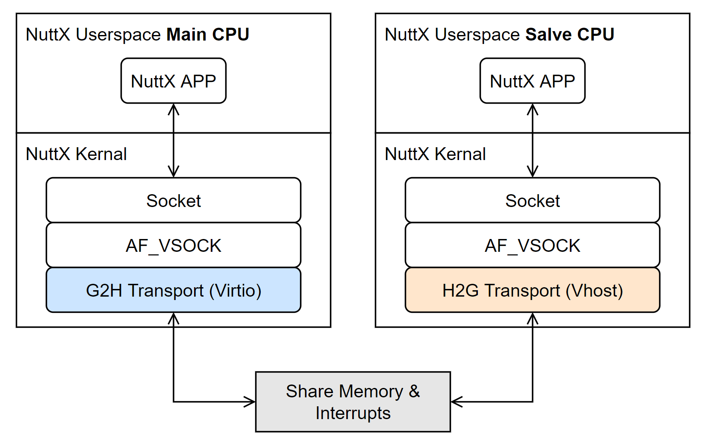
NuttX Online Workshop
Vsock G2H/H2G Transport
We can make two NuttX applications running on different CPU communicate with each other by using the vsock.
Figure 9
Notes:
And more, with the Guest to Host and the Host to Guest transport support,
two NuttX applications run on different CPU can communicate with each other too.
But the Host to Guest Transport is based on the vhost framework, to achieve this goal, we have to implement the vhost framework first.

Slide 17
NuttX Online Workshop
End
Notes:
The Virtio Framwork part is finished, let’s moving on to the next section, talk about the future work.

Slide 18


Thank you!​
Email: wangbowen6@xiaomi.com
NuttX Online Workshop
Notes:
That’s all my presentation, Thank you for listening.

